Slide 1
Logic Families – RTL, DTL, TTL
By- chandramouli Haldar

Slide 2
Introduction to Logic Families
What is a Logic Family?
A group of digital logic gates built using similar circuit design
Defines voltage levels for logic 0 and logic 1
Determines speed, power consumption, and noise margin
Important foundation before CMOS and VLSI design

Slide 3
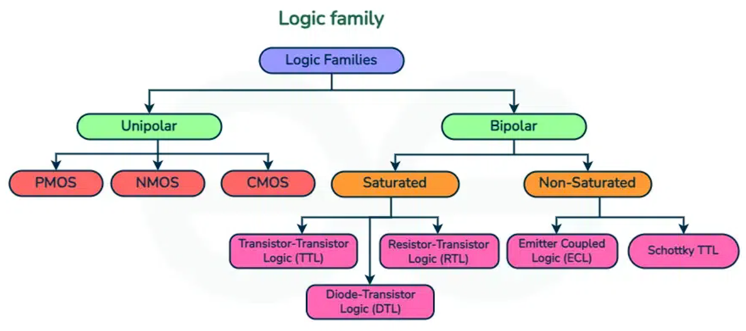

Slide 4
RTL – Resistor Transistor Logic
What is RTL?
RTL stands for Resistor Transistor Logic.
It is one of the earliest digital logic families developed using:
Resistors for input network
Bipolar Junction Transistor (BJT) as a switching device
It was widely used in early digital computers (1950s–1960s).

Slide 5
Basic Components Used in RTL
RTL circuits mainly use:
NPN Transistor
Input Resistors
Power Supply (Vcc)
Ground
The transistor acts like an electronic switch.

Slide 6
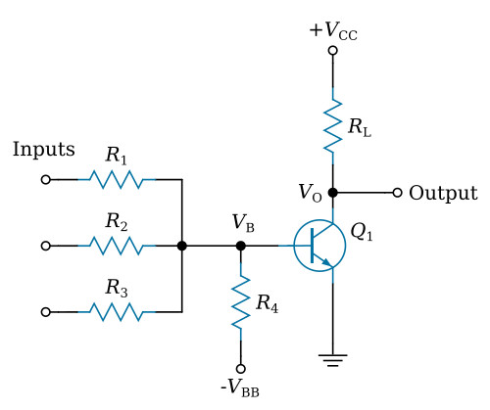
Basic RTL Circuit (NOR Gate)
RTL mainly implements a NOR gate.
Why NOR?
Because the circuit structure naturally produces NOR operation.

Slide 7
Working of RTL (Step-by-Step)
Let us understand using a 2-input NOR gate.
Case 1: Any Input = HIGH (1)
Base of transistor gets voltage
Transistor turns ON
Current flows from collector to emitter
Output becomes LOW (0)
Case 2: All Inputs = LOW (0)
Transistor remains OFF
No current flows
Output becomes HIGH (1)
So, output is HIGH only when all inputs are LOW → NOR logic.

Slide 8
Advantages & Disadvantages of RTL
Very simple circuit design
Easy to understand and analyze
Low component cost (in early days)
Suitable for small circuits
Good for learning basic transistor switching.
High power consumption
Low noise margin
Slow switching speed
Limited fan-in and fan-out
Not suitable for large-scale integration
Because resistors consume power continuously.

Slide 9
Applications of RTL
Early computers
Small digital circuits
Basic logic gate implementation
Educational laboratories
Academic learning
Understanding transistor switching behavior

Slide 10
Why RTL Was Replaced?
Problems in RTL:
Too much power consumption
Heat generation
Poor noise immunity
Limited performance
So engineers developed:
RTL → DTL → TTL → CMOS
CMOS solved most of these problems.

Slide 11
Summary of RTL
Oldest transistor-based logic family
Uses resistors + transistor
Mainly implements NOR gate
Simple but inefficient
Not suitable for modern VLSI
RTL is important to understand the evolution of digital electronics.

Slide 12



Slide 13
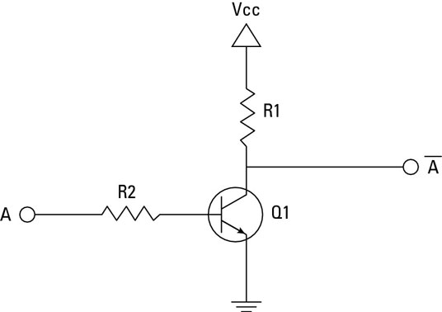
RTL NOT Gate

Slide 14
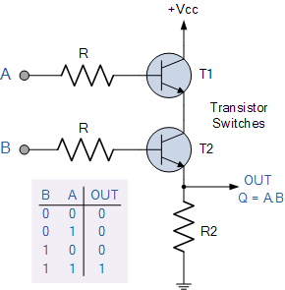
RTL AND Gate

Slide 15
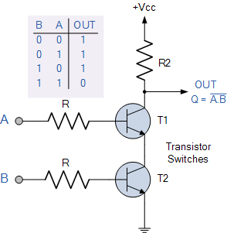
RTL NAND Gate

Slide 16
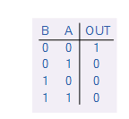
RTL NOR Gate

Slide 17
RTL OR Gate

Slide 18
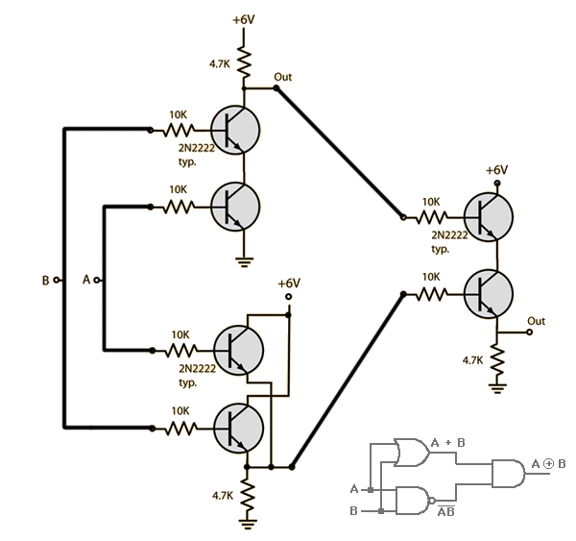
RTL XOR Gate

Slide 19
DTL – Diode Transistor Logic
DTL stands for Diode Transistor Logic.
It is a digital logic family that uses:
Diodes for input logic operation
Transistor (BJT) for switching and amplification
DTL was developed to improve the limitations of RTL.

Slide 20
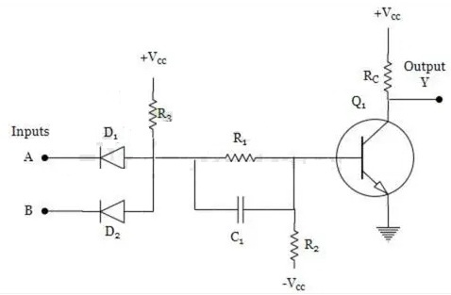
Basic Components Used in DTL
A DTL circuit mainly uses:
Input Diodes
NPN Transistor
Resistors (biasing and load)
Power Supply (Vcc)
Ground
Diodes perform the logic function.
Transistor acts as a switch and amplifier.

Slide 21
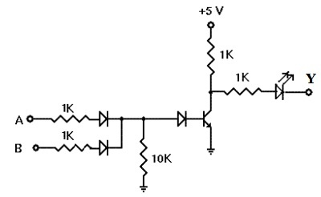
Basic DTL Circuit (NOR Gate)
DTL can implement logic gates like:
NOR
NAND (more commonly used)
Here we explain using a NOR gate for understanding.

Slide 22
Working of DTL (Step-by-Step)
Let us understand using a 2-input DTL gate.
Case 1: Any Input = HIGH (1)
Corresponding diode becomes forward biased
Current flows through diode
Transistor base gets voltage
Transistor turns ON
Output becomes LOW (0)
Case 2: All Inputs = LOW (0)
All diodes are reverse biased
No base current to transistor
Transistor remains OFF
Output becomes HIGH (1)
Output is HIGH only when all inputs are LOW → NOR logic.

Slide 23
Advantages & Disadvantages of DTL
Advantages:
Better noise margin than RTL
Improved reliability
More stable operation
Slightly faster than RTL
Disadvantages:
Higher power consumption
Diode voltage drop reduces performance
Slower compared to TTL
Not suitable for large-scale integration

Slide 24
Applications of DTL
DTL was used in:
Early digital computers
Control systems
Basic logic circuits
Industrial electronics (1960s era)
Today it is mainly used for:
Academic learning
Understanding evolution of logic families

Slide 25
Summary of DTL
DTL = Diode Transistor Logic
Uses diodes for logic + transistor for switching
Better than RTL
Still consumes significant power
Eventually replaced by TTL and later CMOS
DTL is an important step in the evolution of digital logic toward modern VLSI.

Slide 26
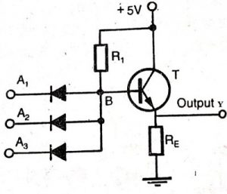
DTL AND Gate

Slide 27
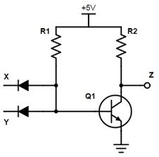
DTL NAND Gate

Slide 28
DTL NOR Gate

Slide 29
DTL OR Gate

Slide 30
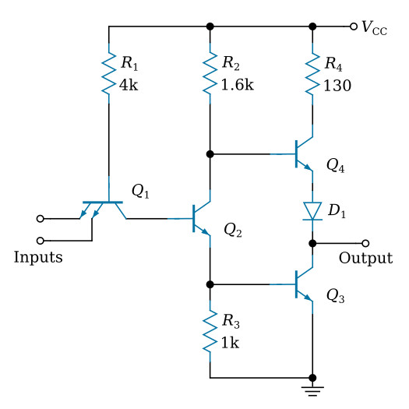
TTL – Transistor Transistor Logic
TTL stands for Transistor Transistor Logic.
It is a digital logic family that uses:
  Transistors for input logic operation
  Transistors for switching and amplification
Unlike DTL, TTL does not use input diodes.
TTL was developed to:
Increase speed, Reduce switching delay, Improve reliability

Slide 31
Basic Components Used in TTL
A TTL circuit mainly uses:
Multi-emitter NPN transistor (input stage)
Phase splitter transistor
Output transistor stage (Totem-pole output)
Resistors for biasing
Power supply (Vcc)
All operations are performed using transistors only.

Slide 32
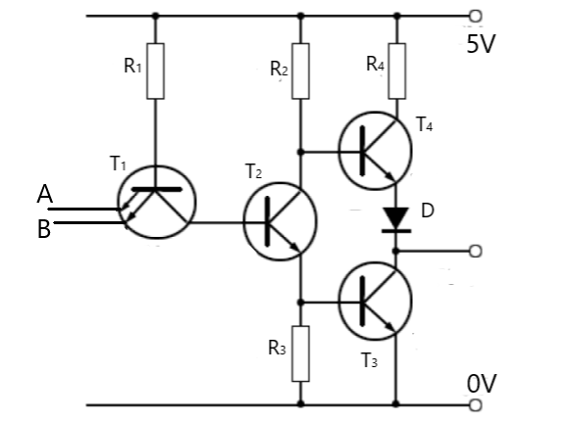
Basic TTL Circuit (NAND Gate)
TTL mainly implements a NAND gate.
The basic TTL NAND gate contains:
Multi-emitter input transistor
Phase splitter
Totem-pole output stage

Slide 33
Working of TTL (Step-by-Step)
Let us understand using a 2-input NAND gate.
Case 1: Any Input = LOW (0)
Corresponding emitter-base junction becomes forward biased
Input transistor conducts
Output transistor arrangement produces HIGH output
Output = 1
Case 2: All Inputs = HIGH (1)
Input transistor turns OFF
Phase splitter activates
Output transistor pulls output LOW
Output = 0
Output is LOW only when all inputs are HIGH → NAND logic.

Slide 34
Advantages & Disadvantages of TTL
Advantages:
Much faster than RTL and DTL
Good noise margin
Better fan-in and fan-out
Reliable operation
Widely used in digital systems
Disadvantages:
Higher power consumption than CMOS
Generates more heat
Limited integration density
Not suitable for very large-scale integration

Slide 35
Applications of TTL
TTL was widely used in:
Microprocessors (early generations)
Digital control systems
Counters and registers
Industrial automation
Communication systems
Many IC series like 74xx were based on TTL.
Today TTL is mostly replaced by CMOS in VLSI systems.

Slide 36
Summary of TTL
TTL = Transistor Transistor Logic
Uses only transistors
Faster than RTL and DTL
Good noise margin
Widely used before CMOS
Eventually replaced by CMOS due to high power consumption
TTL is a major milestone in the evolution of digital logic toward modern VLSI.

Slide 37
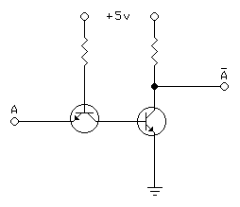
TTL NOT Gate

Slide 38
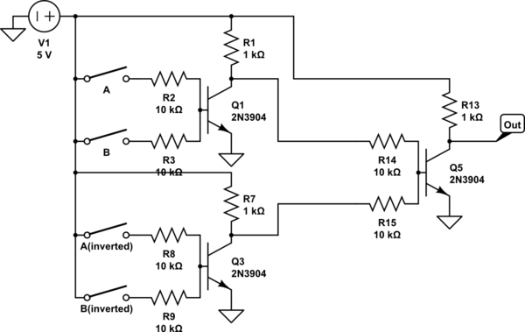
TTL Half Adder

Slide 39
PRACTICE
FULL ADDER
HALF SUBTRACTOR
FULL SUBRACTOR
4x1 MUX
1x4 DEMUX
SR Flip Flop

Slide 40
THANK YOU!
The class will end at 1:30, not before that.

